Slide 1

NOria: Dynamic, partially-stateful data flow for high-performance web applications
Lakshmi Sampath Somanath Pagolu | CS5352 | Instructor: Tommy Dang

Slide 2
Content
Introduction
Design
Challenges and solutions
Implementation
Limitations
Evaluation

Slide 3
Introduction
How it works and Why do we need a new DB for web applications

Slide 4
Web applications
Many web applications are read heavy
Must serve data with the lowest latency possible
Hence many web applications use Memory caches like Redis or Memcached
Can we remove external caching needs and make the DB even faster than Memcached?
Can we avoid cache validations and thundering?

Slide 5
Noria: Data flow engine
Noria looks like a RDBMS on the outside
But it is a data flow engine in the inside with a persistent storage and materialized views
The main concept is to maintain caches for reads in the DB itself
And update them while executing writes
Applications change over time and Noria updates dynamically
It accommodates for stale reads

Slide 6
Design
The idea and the data flow engine principles

Slide 7
Design
Noria runs on one or more multicore servers that communicate with each other using RPCs
Noria stores both base tables and derived views
Base tables are stored persistently either on one server or sharded across multiple servers
Views are stored on server memory
It has two interfaces SQL query-based interface and a programming interface
Eventually consistent

Slide 8
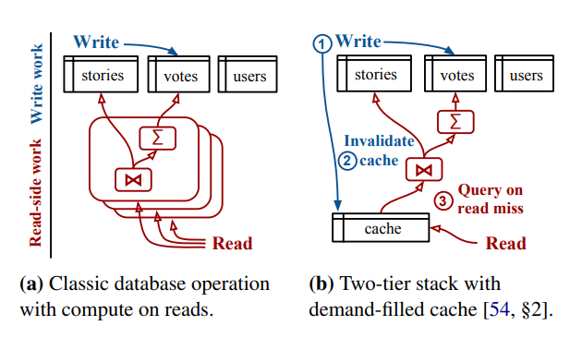
Basic web application with caching solution

Slide 9
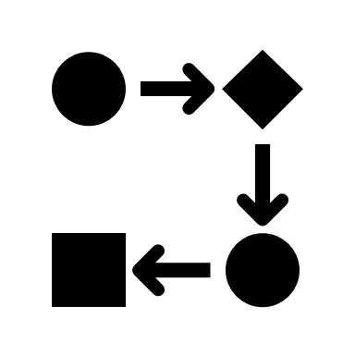
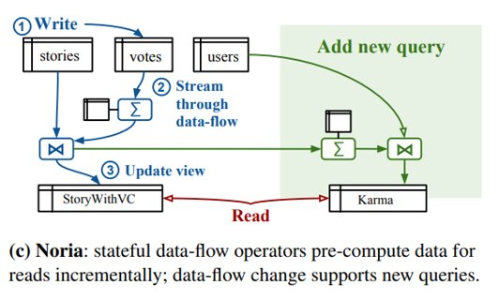
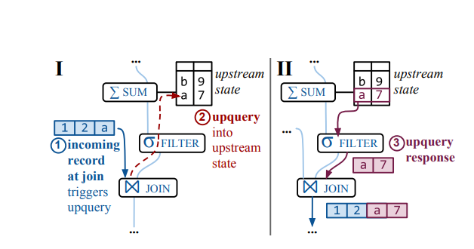
Data flow execution
The data flow consists of acyclic graph of relational operators such as aggregators, Joins and filters
  Base tables are the roots
When a write arrives,
  It stores the data in a persistent base table
  After it injects into the data flow as an update
It takes time to propagate through the data flow and reach the view making Noria Eventually consistent
To achieve maximum parallel processing Noria avoids global process tracking or coordination

Slide 10
Two Challenges
Limit the size of its views
Adapt to the application changes dynamically i.e. without downtime

Slide 11

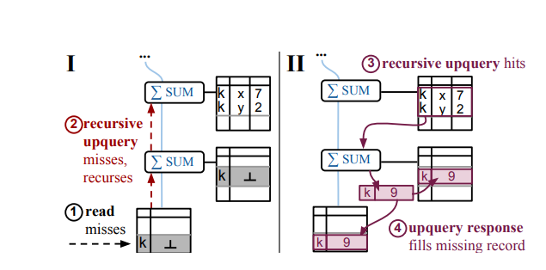
Partially stateful dataflow
Eviction notices are flown forward along the data flow
These indicate some states are not going to be updated any more
What if in the future, an evicted state needs to be read?
Noria also maintains a full state for special cases

Slide 12

Dynamic dataflow
Noria first plans out the transition
It evaluates what operators to remove and the ones to be added along the data flow
Incrementally updates the dataflow
Once both steps are executed the application can use new tables and queries
It bootstraps partial and full state operators differently
Base table changes

Slide 13


implementation
Implemented using Rust
Applications interface using Rust bindings , using JSON over HTTP or MYSQL protocol adapter
Uses RocksDB for persistent base tables
Parallel Processing – allows concurrent reads and writes with minimal synchronization
Distributed operation –uses zookeeper for maintaining the controller and for clients to discover the controller

Slide 14
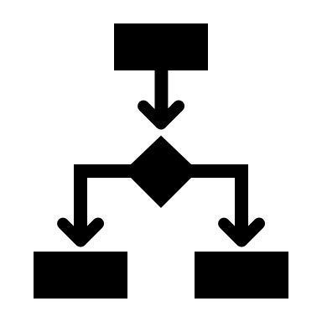
Distributed operation
A Noria controller manages distributed Noria instances to inform them of data flow changes and of shard assignments
Noria selects a controller and persists it states using zookeeper
Zookeeper is used by clients to discover the controller and obtain reads and send writes to instances
If the controller fails it elects a new one and uses RocksDB to create fully stateful operators and views
If individual instance fails it only rebuilds operators which were affected.

Slide 15
Parallel processing
Sharding:
Noria processes updates in parallel by hash partitioning each operator on a key and assigns shards to different servers
Each machines runs Noria server and contains a complete copy of dataflow graph but holds state of its shards of each operator
Multicore Parallelism:
A server can handle multiple shards by running multiple Noria instances
Each instance has two thread pools:
Data flow workers
Read handlers
At most one data flow worker executes updates for each operator for lock free processing
Noria also schedules chain of operators with one key, which allows performing upqueries without worrying about inflight updates
Noria uses double buffered hash tables for external views for concurrent reads and writes
This avoids locking
Implemented using a new data structure called evmap

Slide 16

Limitations
It does not support resharding, as resharding requires sending updates in a single instance
Dataflow is recomputed when a failure occurs
It doesnot support range indices and multi column joins

Slide 17
Comparisions with other DataBases
Based on production environment of lobsters hosted on AWS

Slide 18
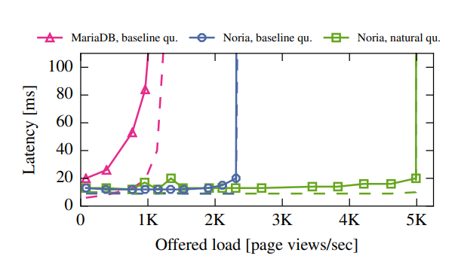
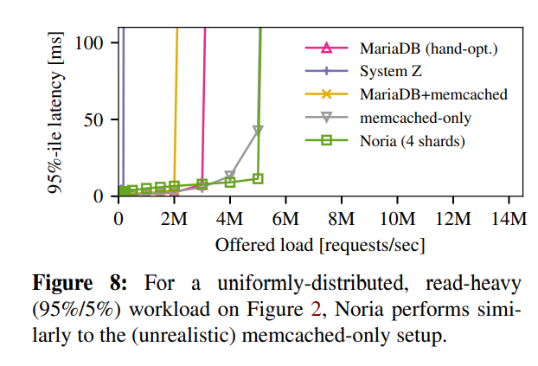
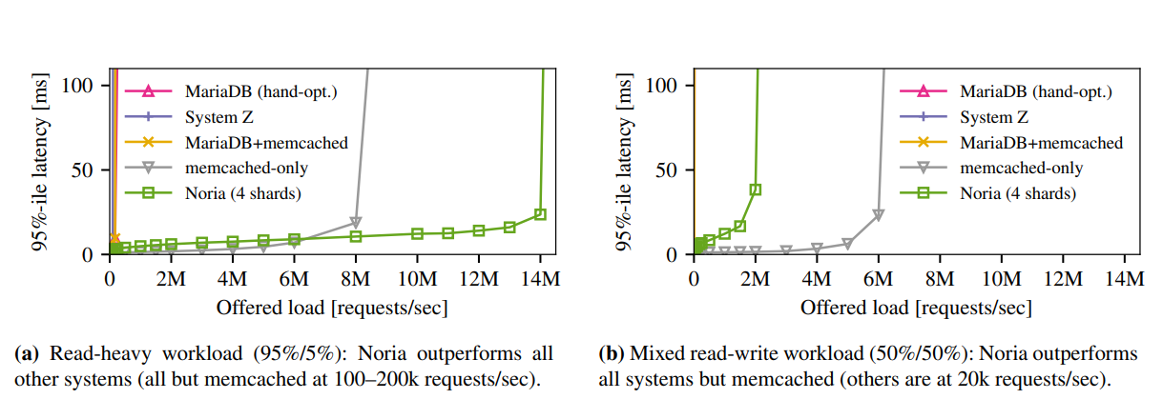

Slide 19

References:
https://pdos.csail.mit.edu/papers/noria:osdi18.pdf
https://notamonadtutorial.com/interview-with-norias-creator-a-promising-dataflow-database-implemented-in-rust-352e2c3d9d95
https://corecursive.com/030-rethinking-databases-with-jon-gjengset/
https://github.com/mit-pdos/noria
https://www.youtube.com/watch?v=s19G6n0UjsM
Thank You

